Slide 1
AP Chemistry- Mrs. Adams
Agenda
Seating
Warm Up
Handouts
Procedures
Study for Quiz !!!
Notes:
Greet and Seat
Start Warm Up
Lecture
Star Activity

Slide 2
Seating
Seating will be in alphabetical order.
Find your number and sit at the corresponding desk.
Read the Warm Up.

Slide 3
If you can’t be right, at least be amusing….

Slide 4
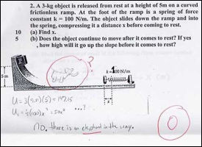

Slide 5
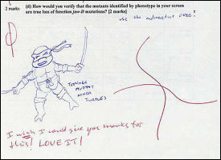

Slide 6
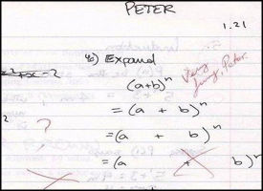

Slide 7
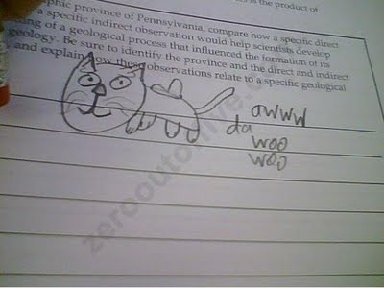

Slide 8
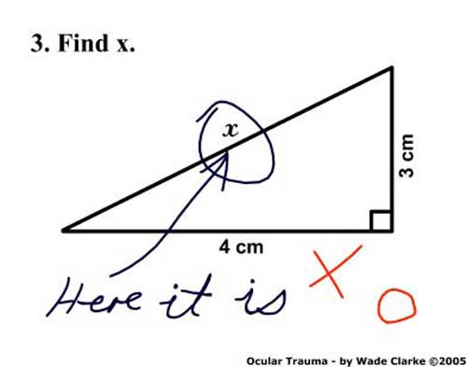

Slide 9
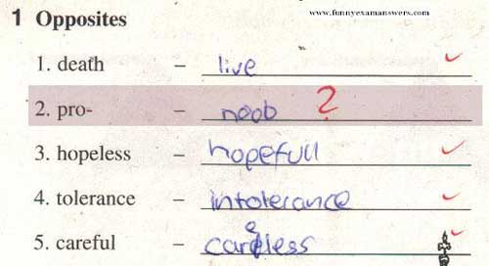

Slide 10
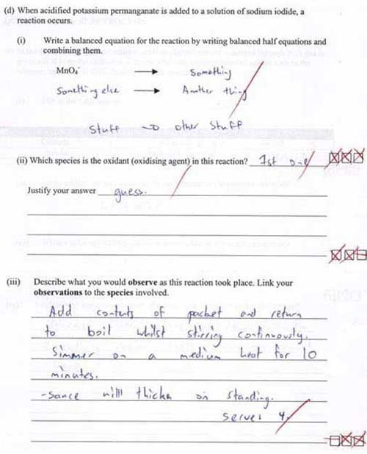

Slide 11
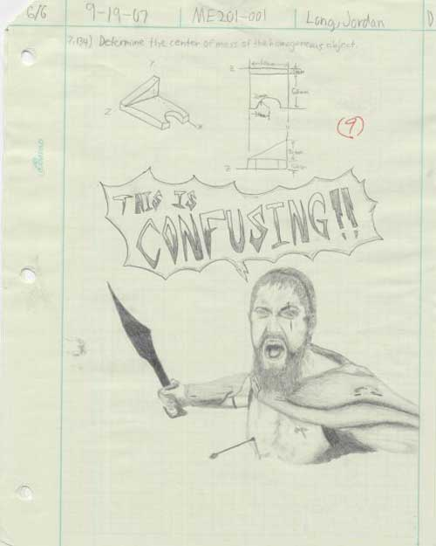

Slide 12
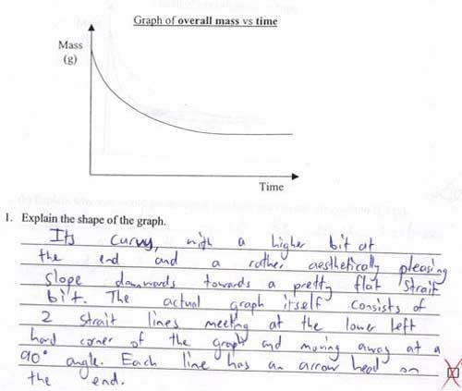

Slide 13
